Slide 1

Head of Communications and Corporate Affairs
Grade: HMG 1 (£74,000 to £95,000)
Directorate: Strategy and Transformation
Reports to: Director of Communications, Culture and Engagement

Slide 2

PURPOSE OF THE ROLE
Working collaboratively with colleagues and Members, you are responsible for ensuring corporate communications is purposeful, professional and effective, reaching the right audiences with the right message. You will lead on the development and implementation of a new communications strategy to support the ambitions of our new corporate plan.
The work of your team will ensure residents, businesses and other stakeholders are informed of Council services, policies and decisions, and the opportunities available to them. You will raise the profile and influence of the Council as one of London’s leading local authorities and, with your radar for risk and grip on issues management, protect our reputation.
Your impactful behaviour change campaigns will demonstrably improve outcomes, and you’ll help embed a strong identity for the Council and place brand for the borough, which galvanises partners and attracts people to live, work, visit and invest in Hounslow.
Through strategic internal communications you will empower colleagues with the information and tools they need to do their best job, engaging them with the Council’s vision and fostering a culture of advocacy.

Slide 3
YOUR CONTRIBUTION (ROLE SPECIFIC)
Drive the continuous development and delivery of a high-performing communications service, ensuring activity is aligned to corporate objectives and appropriately resourced.
Deliver effective campaigns across media relations, public affairs, digital and social media, marketing and publications, design, and colleague and Member communications, ensuring work has clarity of purpose and measurable impact.
Champion a strong and distinctive brand and identity for the Council and borough that resonates locally, across London and beyond.
Shape and maintain high-quality communications products, including publications, social media channels and e-newsletters, ensuring consistency, audience focus and clear purpose.
Develop impactful awareness and behaviour change campaigns that cut through the noise, engage target audiences and achieve measurable outcomes.
Establish and maintain effective policies and protocols for issues management and crisis communications, including oversight of the Communications team’s on-call rota.

Slide 4
YOUR CONTRIBUTION (ROLE SPECIFIC)
Be a lead source of intelligence, advice and constructive challenge for officers, Members and partners on communications and reputational matters.
Provide colleagues and Members with advice, training and tools to communicate effectively, embedding consistent high standards.
Work in collaboration with key partners, in particular Lampton Group and Hounslow’s Borough Based Partnership, to ensure communications is aligned and reach is maximised.
Form effective and influential relationships with public sector partners, other London boroughs, community groups, businesses and regional and national government to support corporate objectives.
Achieve income generation targets through advertising in corporate communications channels, and continually look for further commercial opportunities.
Lead a multi-disciplinary service with an ethos of professionalism, creativity, collaboration, equality, being driven by data and learning from best practice, particularly around the use of AI.

Slide 5
YOUR CONTRIBUTION (CORPORATE)
Lead with a strong commitment to Equality, Diversity and Inclusion, embedding these principles into every aspect of service delivery.
Be an ambassador for the Council and borough, enhancing the Council’s image and championing the interests of Hounslow’s communities, stakeholders and partners.
Demonstrate continuous improvement of your services with effective performance monitoring and evaluation.
Ensure your service aligns with Hounslow's digital strategy, driving digital transformation and innovation.
Promote and implement the Council’s Green Recovery Strategy and Climate Emergency Action Plan within your area of responsibility.
Deliver services within available resources, ensuring budgets are well managed, income targets are achieved and opportunities to reduce costs or generate extra income explored.
As an active part of the Hounslow’s Leadership Group, work with senior officers across the Council to achieve positive corporate outcomes and drive change.
Deputise for the Director of Communications, Culture and Engagement as needed.

Slide 6
THE MOST IMPORTANT THINGS ABOUT YOU
You will bring significant experience of communications leadership in a local authority or organisation of comparable complexity. An effective manger, you organise and inspire teams, delivering high standards and improvement within your service.
Collaborative in spirit and with strong persuading and influencing skills, you can galvanise people and organisations to your cause. Coupled with corporate and political acumen you develop productive working relationships.
With excellent technical and interpersonal skills, you can present effectively to diverse audiences and command respect, trust and confidence.
You’re a strategic thinker who sets clear and measurable objectives with a route to achieve them, while horizon scanning to minimise risk and maximise opportunity. You’re adept at managing competing priorities to deadlines, delivering complex work programmes and responding to new situations.
You engage in continuous professional development, seeking out best practice and developing networks across the sector. You inspire your team to do the same, while instilling your high standards and ethos of keeping abreast of new methods and platforms to improve the efficacy of communications.

Slide 7
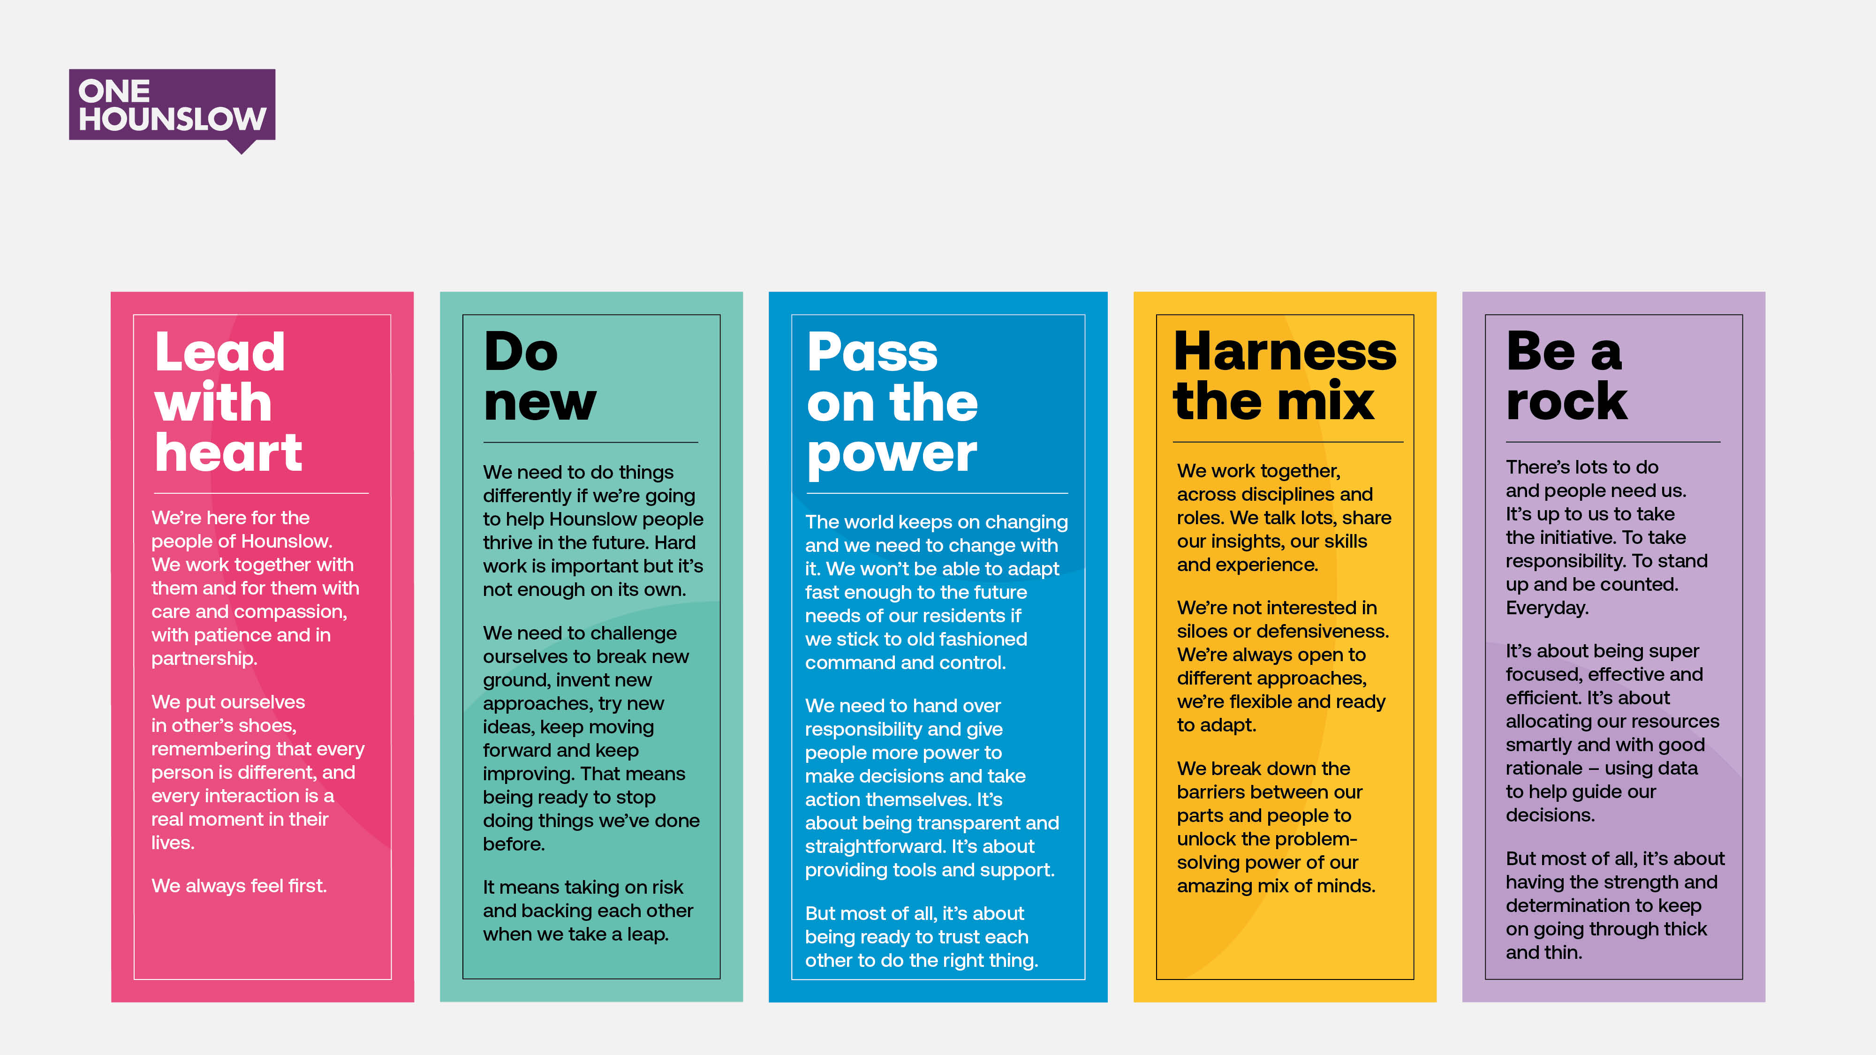
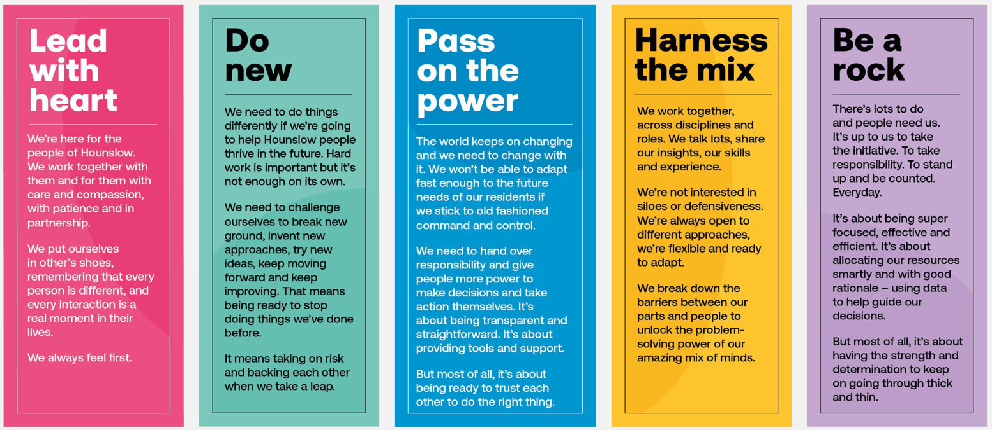
THE ONE HOUNSLOW VALUES THAT DRIVE US

Slide 8

EQUALITY IN ALL WE DO
We value diversity in its broadest sense. We're committed to creating an inclusive culture where everyone is able to be themselves, give their best and reach their full potential. We believe that a diverse workforce helps us to better understand our communities and deliver the best services for our residents. We want to receive applications from all regardless of age, gender identity, disability, marriage or civil partnership, pregnancy or maternity, religion or belief, race or ethnic origin, sex, sexual orientation, transgender status or social economic background. We want to harness the mix and ensure that everybody can apply and be part of our recruitment processes. We will therefore make reasonable adjustments to accommodate our candidates.

Slide 9

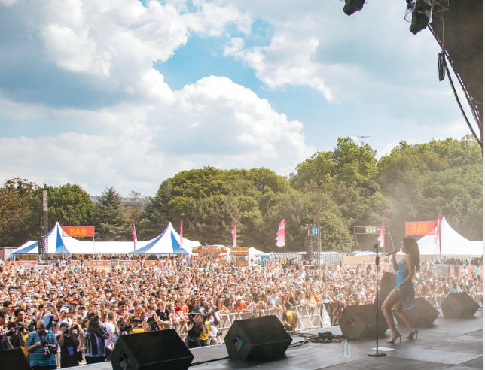

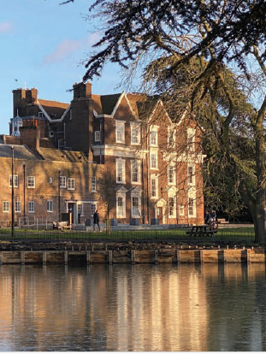
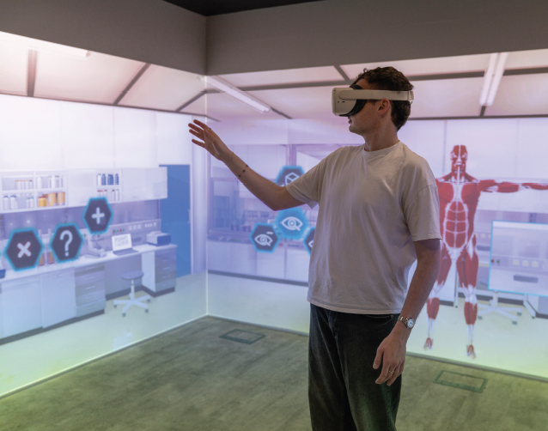

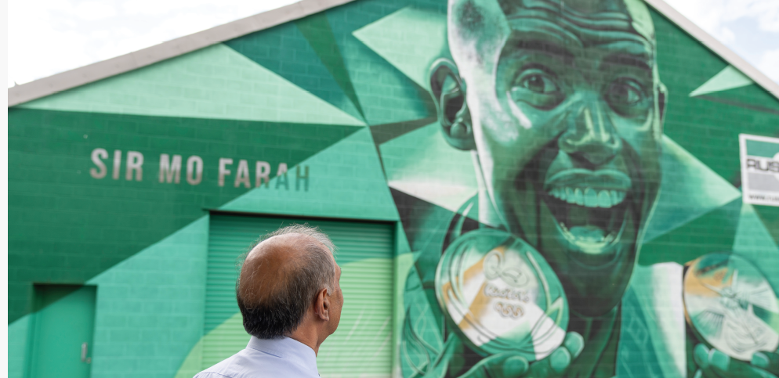
LONDON IN ONE BOROUGH, THE WORLD IN ONE PLACE
Hounslow is one of London’s most diverse, dynamic and connected boroughs. Home to 300,000 people speaking 188 different languages, we stretch from Chiswick in the East, through to Brentford, Hounslow and Feltham in the West, and represent people from all walks of life.
Our economy is one of the largest of any local authority area in the UK. We have a dynamic, industrious and entrepreneurial business community – from the HQs of global brands to cutting edge start-ups – and are leading the way in media, gaming and tech, with a fast-growing creative sector.
Bustling town centres, quality schools, wonderful parks and waterways, and world-class historic attractions make for a great place to live, work and visit.

Slide 10

EMPLOYEE BENEFITS
Annual leave – Generous annual leave entitlements starting from 25 days and rising to 31 days.
A range of family friendly leave options – Maternity, Paternity, Parental and Shared Parental Leave
Premature baby leave and pay – We are proud to have The Smallest Things Chartermark.
Christmas closure – Up to 3 days, between Christmas and New Year, if your office is closed.
Flexible working arrangements – our focus is on the outcomes you deliver and we are flexible about where and how this is best achieved.
Local Government Pension Scheme – Open to all employees, this is a tax approved, occupational pension scheme. Your contributions are based on a sliding scale according to your salary band.
Learning and development – we want you to learn everyday. We have a fantastic range of resources and opportunities and are committed to your development throughout your career with us
Travel options – Pool cars, Pool Bikes, Season Ticket Loans.
Staff wellbeing services – Including access to Occupational Health, an Osteopath/Chiropractor and Employee Assistance Programme.
For more information visit hounslow.gov.uk/working-council

Slide 11
HOW TO APPLY
For a confidential discussion about the role, contact Sunita Patel (07561708023/sunita.patel@starfishsearch.com)
For more information and to apply, visit: https://starfishsearch.com/jobs/Hounslow-hocaca
To make an application, please click on the ‘apply now’ button on this webpage, with the following prepared:
Your CV (no more than three sides of A4).
A supporting statement (no more than three sides of A4) that sets out why you think this role is the right move for you and how you meet the knowledge and experience criteria.
If you would like to apply under the Disability Confident Scheme, please state that clearly at the top of your supporting statement, along with any adjustments you require to be made if invited for interview.

