Slide 1
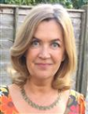
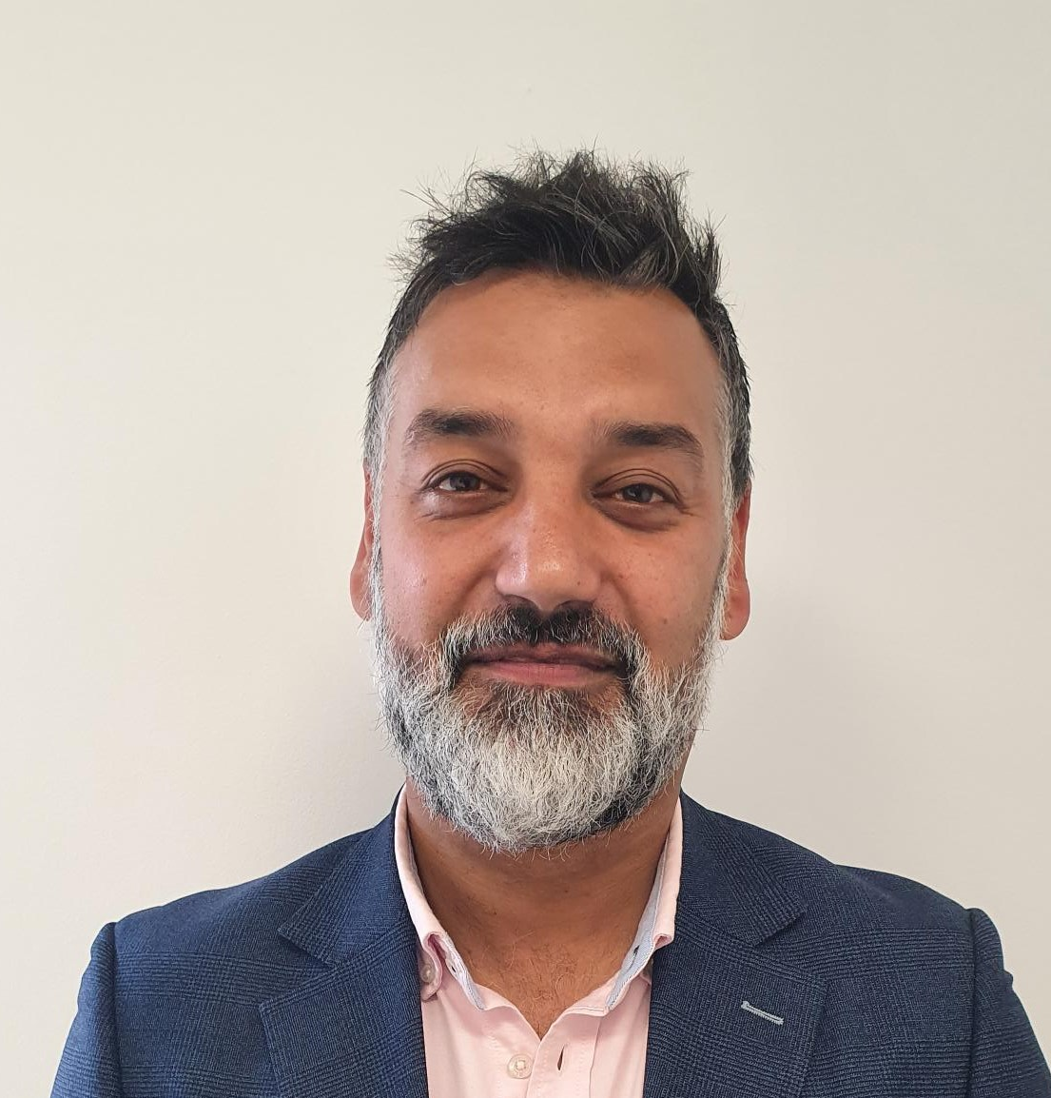
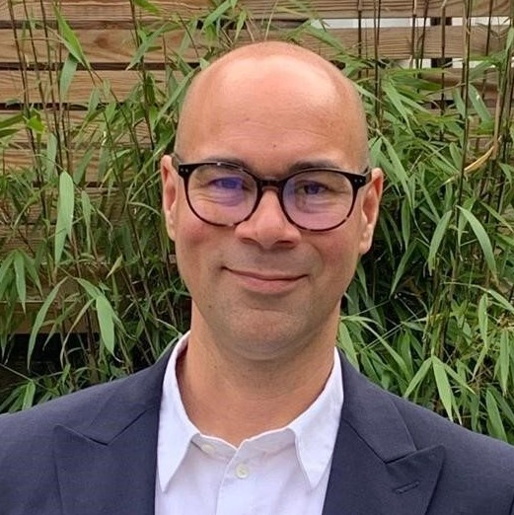
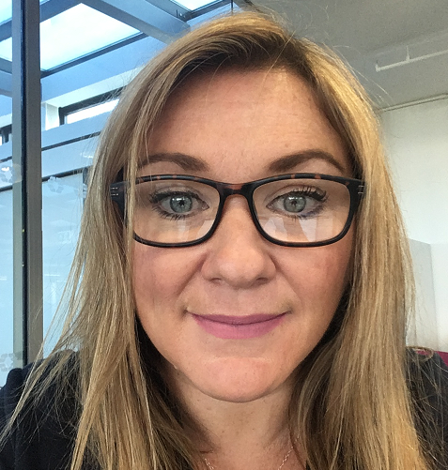
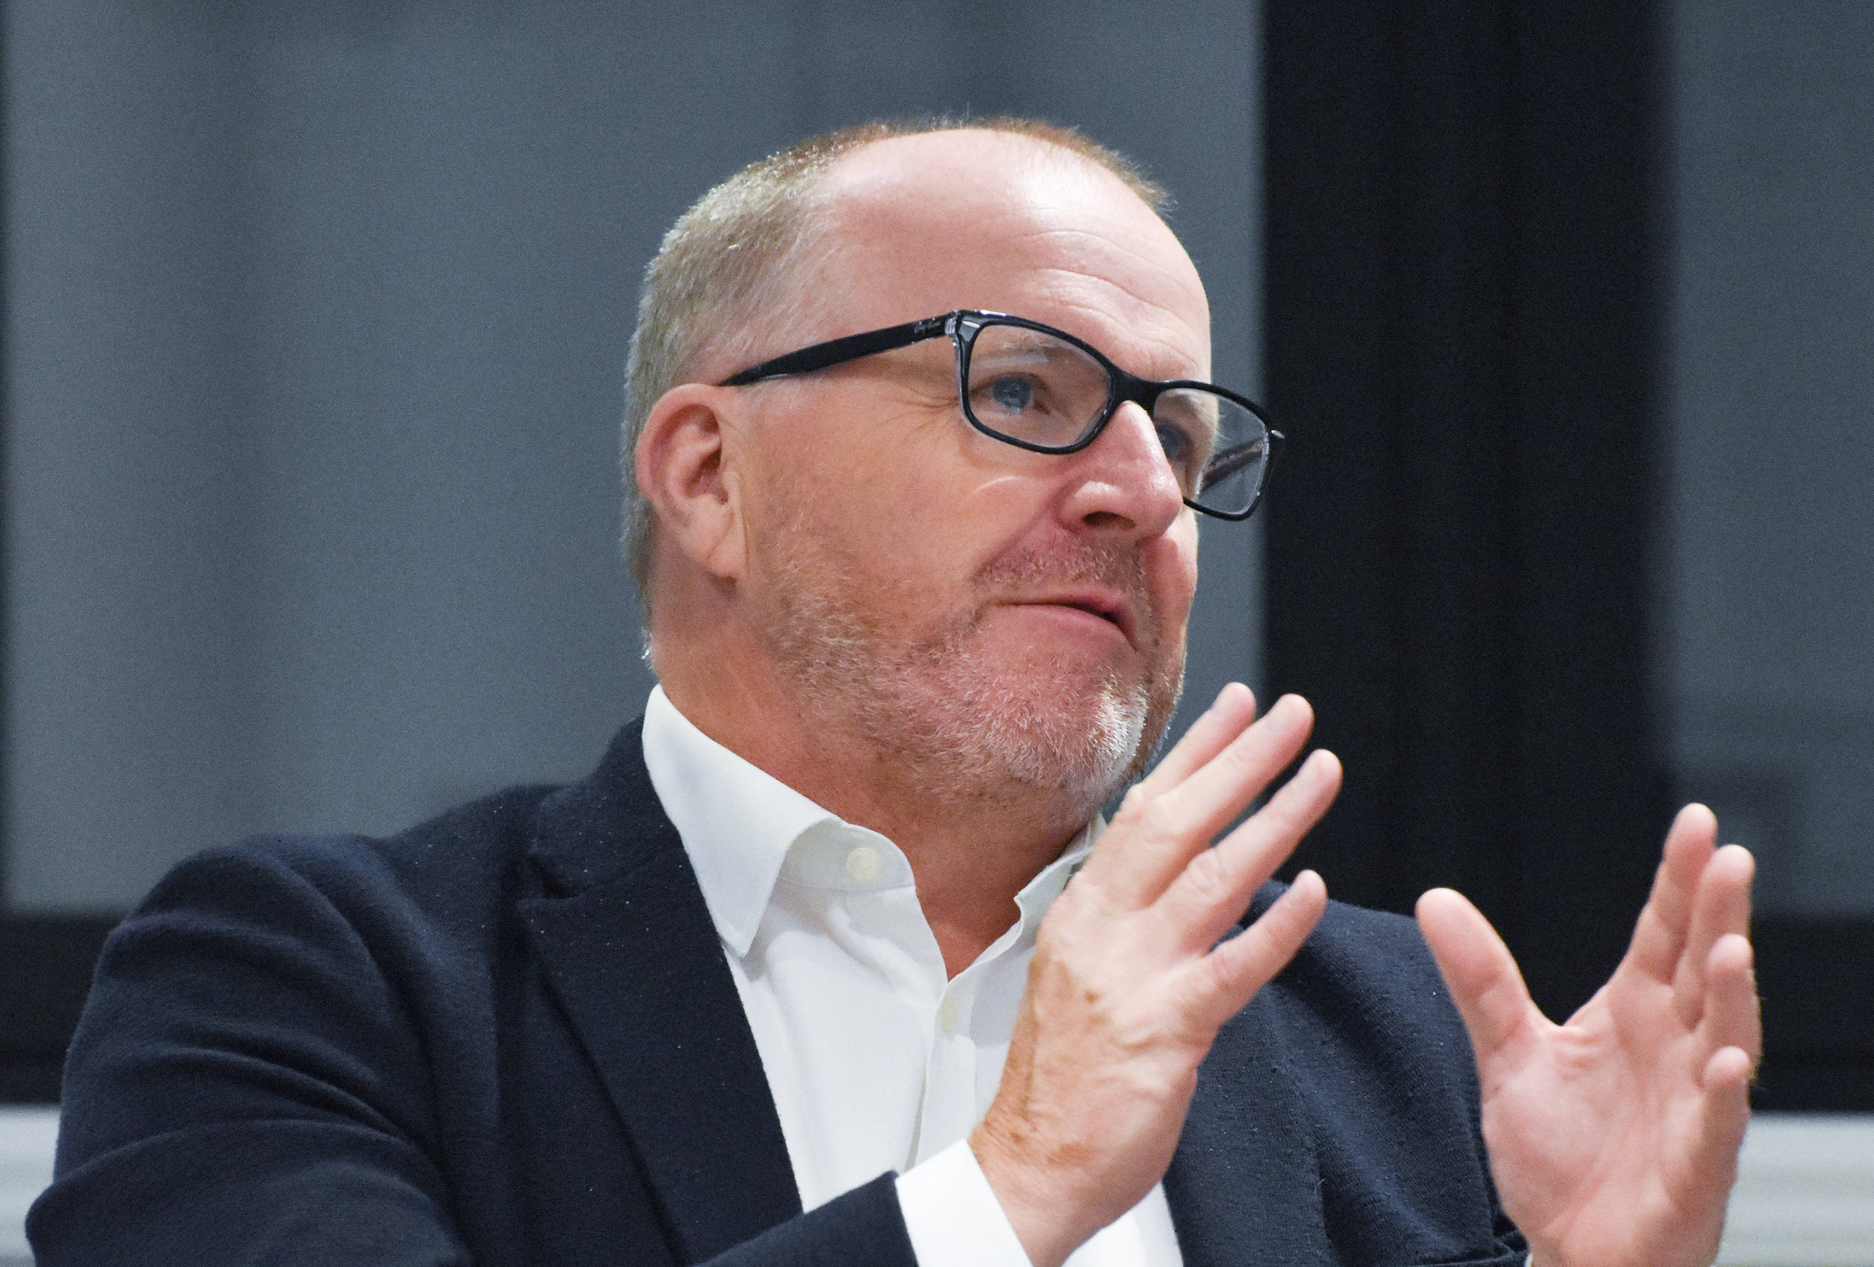
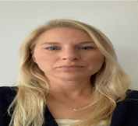
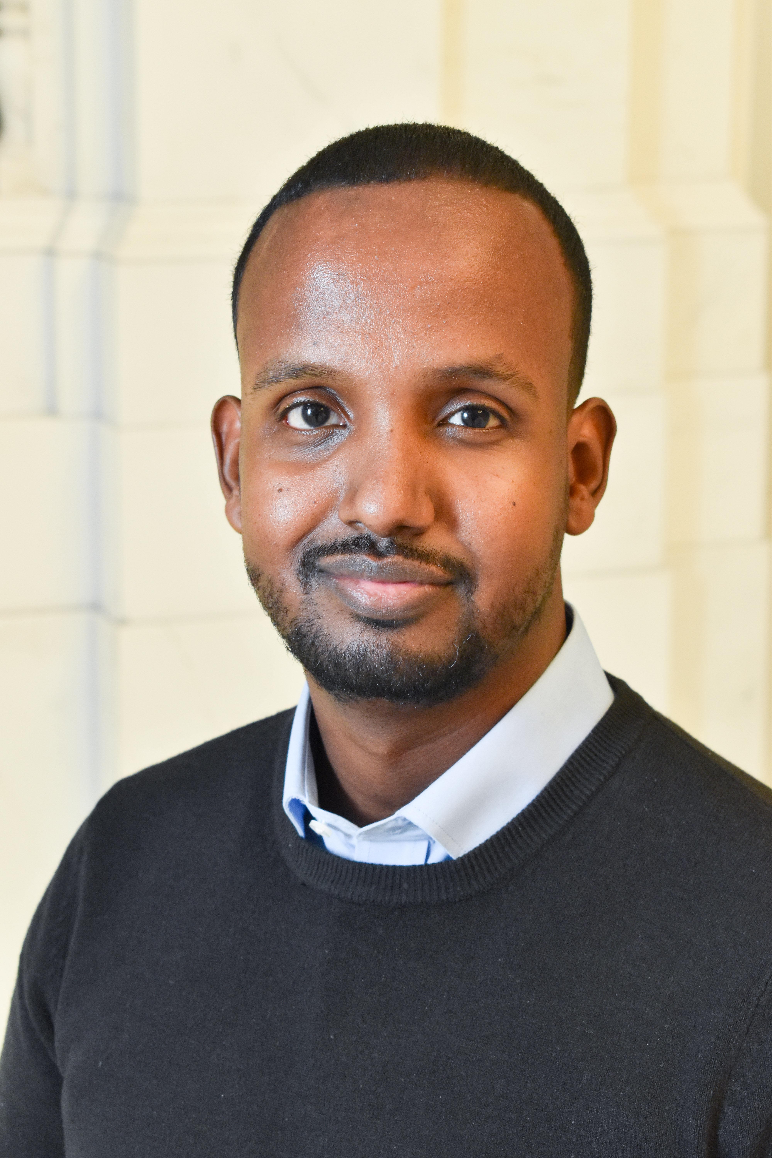
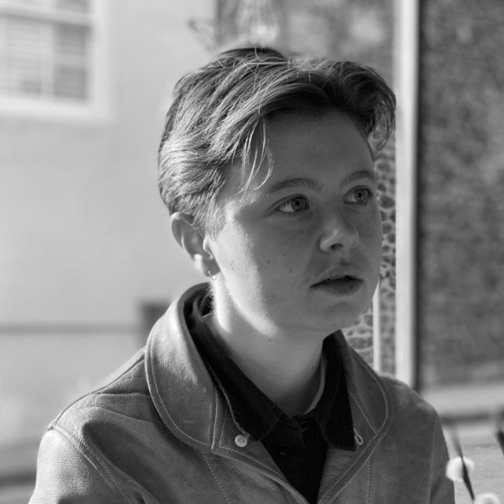
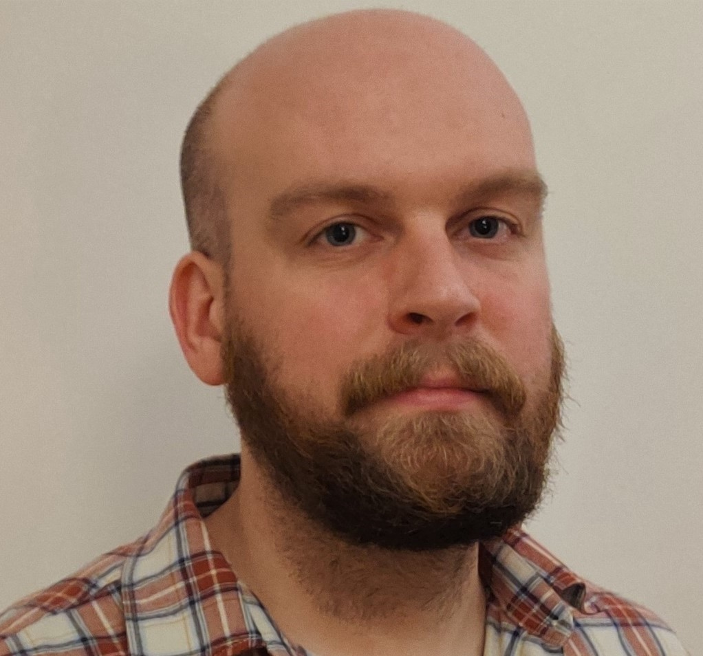
Camden Council Top Level Structure Chart
Chief Executive Jenny Rowlands
Executive Director
Supporting Communities
Gillian Marston
Executive Director
Corporate Services
Jon Rowney
Executive Director Adults and Health Integration Supporting People Jess Mcgregor
Executive Director
Children and Learning Supporting People
Tim Aldridge
Director of Participation, Partnerships and Communications
Kathryn Myers
Borough Solicitor
Andrew Maughan
Director of Health and Wellbeing
Kirsten Watters
Director of Equalities and Community Strength
Hanad Mohamed
Director of Director of Corporate Strategy and Policy Design
Osian Jones
Director of Economy, Regeneration and Investment
David Burns
Director of People & Inclusion
Joanna Brown
Last updated: June 2024

Slide 2
Executive Director Corporate Services
Jon Rowney [Section 151 Officer]
Participation, Partnerships & Communications Kathryn Myers
Chief Digital & Information Officer
Tariq Khan
Borough Solicitor, Law & Governance [Monitoring Officer]
Andrew Maughan
People & Inclusion
Jo Brown
(Reporting to CE)
Finance
Daniel Omisore
Director of Corporate Strategy and Policy Design
Osian Jones
Equality & Community Strength
Hanad Mohamed
Strategic Communications
Charlotte Fitzgerald
Digital Products and Services
Louise Brown
Legal Services & Deputy Borough Solicitor
Joyce Golder
People Relationship Leads
Frances Woods
Deirdre Deats
Lauren Carnall
Patricia Hillman
Strategic Finance & Business Partnering
Jason Blackhurst
Head of Missions & Corporate Services Strategy
Equalities & Systems Change Lead
Mathurini Visakan
Media & External Relations
Gareth Jones
Chief Data Officer
Martin Waudby
Finance, Supporting Communities
Michael Webb
Service & Policy Design
Alejandra Diaz
Community
Partnerships
John Muir
Business Support
Kathryn Byrne
People Operations Lead
Ashleigh Calf
Applications
Illesh Chavda (Interim)
Finance, Supporting People
Helen Gardiner
Participation & Partnerships
Caroline Kennedy
Inclusion & Cultural Change
James Kargbo
Strategic Delivery & Operations
Rich Cassidy
Strategic Lead
Guy Arnold
Committee Services
Vicky Wemyss-Cooke
Treasury, Pensions & Financial Transactions
Nigel Keogh (Interim)
Innovation, Insight & Learning
Ian Gilson
Member Support
Olivia Mensah
Operations
Steven Haydon
Insights, Learning and Impact
Michal Shinwell
Debt & Financial Resilience
Zoe Tyndall
Electoral Services
Jeanette Pegler
Relational Practise & Wellbeing
Emma Bown
Finance Capital Hannah Davis
Chief Executive Office
Beth Greenshields
Technology
Andy Snape
Specialist HR Advice (Pay, Policy & Equality)
Zoe Hoskin
Chief Accountant Raj Shah
Mayor’s Office
Margaret Humphrey
Customer & Registration Services
Phil Quickenden
Health & Safety
Darren Williams
Internal Audit, Investigations
& Risk
Nasreen Khan
Cabinet Office
Charlotte Akinola
Employee Relations
Debra L'Esteve
Council Tax, Business Rates& Benefits
Mark Stewart
Resourcing
Wayne Cockerill
Credit Control & Income Management
Anila Bowman

Slide 3
Executive Director Supporting Communities
Gillian Marston
Director of Economy, Regeneration & Investment
David Burns
Director of Property Management
Gavin Haynes
Director of Development
Neil Vokes
Director of Recreation and Public Safety
Oliver Jones
Director of Housing
Glendine Shepherd
Director of Environment and Sustainability
Richard Bradbury
Inclusive Economy
Kate Gibbs
Capital Works
Suzanne Afra
CIP Development
Kate Cornwall-Jones
Steve Downes
Head of Leisure
Katy Knight
Leaseholder Services & Housing Income
Sean Scott
Environment
Services
Rachel Bailey
Strategy Supporting Communities
Julien Danero Iglesias
HS2 Programme Delivery
Ashleigh Watkins
Repairs & Operations
Tony Castle
Head of Libraries,
Fiona Tarn
Sustainability,
Air Quality & Energy
Harold Garner
CIP Programme Office
Noe Ardanaz Ugalde
Neighbourhoods (Housing)
Maria Jacobs
Euston Regeneration
Mary-Ann Lewis
Head of Green Spaces
Darrell Abercrombie
Avid Houghton
Strategic Asset Management and Compliance
Sinead Burke
Head of Property
Martin Olomofe
Housing Solutions
Simone Melia
Engineering Service and Building Control George Loureda
Culture
Zerritha Brown
Head of CIP Technical Design
Michelle Christensen
Community Safety
Pat Coulson
Allocations, Lettings & Private Housing Services
Gerry Crowley
Strategic Lead - Transport Planning
Sam Margolis
Procurement & Social Value
Nicole Penn
Property Customer Services & Engagement
Scot Reid
Environmental Health
Rebecca Whitehouse
Camden Accessible
Transport Solutions
(CATS) Sam Pandya
Chief Investment Officer – Community Wealth Fund
Mathu Jeyaloganathan
Facilities Management
Steve Harris
Safer Homes
Michal Jankowski
Public Protection & Licensing
William Sasu
Chief Planning Officer
Daniel Pope
Resident Safety Engagement
Melissa Dillon
Parking Operations
Peter Mardell
Coronial Services and Business Development Manager
Leon Livermore
Resilience & Public Security
Michael Hrycak
Development Management
Beth Cullen
Chalcots
Astrid Kjellberg-Obst

Slide 4
Executive Director, Supporting People, Adults and Health [statutory DASS]
Jess Mcgregor
Director of ASC Operations and Deputy DASS
Avril Mayhew
Director of ASC Strategy and Commissioning and Deputy DASS
Chris Lehmann
Director of Health & Wellbeing
Kirsten Watters
Head of Integrated Learning Disability Service
Andrew Reece
Head of Adults Commissioning
Theresa Collier/Karen Timperley
Healthy Lives (Adults & Vulnerable Groups)
Sue Hogarth
NCL ASC Programme Lead
Richard Elphick
Head of ASC Neighbourhoods
Bernice Solvey
AD Integrated Commissioning
Debra Holt
Substance Misuse & Sexual Health
Emma Stubbs
Principal Social Worker
Vacant
Public Realm & Wider Determinants of Health
Piers Simey
Head of Adult Social Care Innovation
Cynthia Davis
Health Protection, Health Intelligence & Healthcare
Wikum Jayatunga
Head of ASC Insight, Quality and Financial Services
Jamie Spencer
Head of Provider Services
Laurie Armantrading
Child Public Health
Manuj Sharma
Camden & Islington Foundation Trust
Head of Support and Safeguarding Transformation
Kim Christadoulou (Interim)
Integrated Children’s Commissioning
Julia Mills/Dionne Usherwood
Service Manager, Approved Mental Health Service
David Hamilton
Integrated Strategy & Assurance
Johanna Tuomi-Sharrock

Slide 5
Executive Director, Children and Learning [statutory DCS]
Tim Aldridge
Director of Children’s Prevention, Safeguarding and Family Help
Rashida Baig
Director of Education Commissioning and Inclusion
Vikram Hansrani
Director of Relational Practice
Nana Bonsu
Children in Need
Michelle O’Regan
Virtual School
Head (Interim)
Sheila Durr
Practice and Learning
Sophie Kershaw
Integrated
Youth Service
Tim Cosh
Special Educational
and Inclusion
Intervention Service
Di Osbourne
Chief Executive
Camden Learning
Stephen Hall
Head of Strategy
Finneguela O’Brien
Children and Learning Transformation
Becca Dove
Early Years
Debbie Adams
Head of Business Development & Communications
Ruth Horsman
Portfolio Lead for Children, Schools and Families
Florence Henry
Education, Commissioning &
School Organisation
Nick Smith
London Resettlement Partnership & LARP
Charlotte Matthews (mat cover)
Family Support & Complex Families (interim)
Jessica Eneberi
Quality Assurance
Adele Ellis
Director of STEAM & Partnerships
Danielle Tobin
Head of Data (SP)
Martin Dittus
Looked After Children and Care Leavers
Brenda Amisi-Hutchinson
Adult
Community Learning
Mark Isherwood
Senior Advisor Safeguarding & Inclusion
Chris Roberts
Portfolio Lead for Adults and Health
Children & Young People Disability Service
Crina Popa
Director of Learning
Andy George
Programme Lead ASC Transformation
Katie Gilman
Head of Governor Services & Company Secretary
Owen Rees
Head of Finance & Business Systems
Melanie Robinson (from Sept 2024)

