Slide 1
Commissioning restructure case for change executive summary October 2023

Slide 2
Table of contents
Section | Pg
1. Executive Summary | 3
2. Aligning Our Strategic Priorities | 4
3. Our Challenges | 5
4. Our Vision | 6
5. Shift in Commissioning Practice | 7
6. A Commissioning Approach for Greenwich | 8

Slide 3
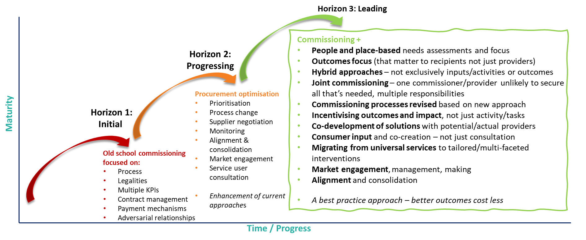
EXECUTIVE SUMMARY
Greenwich is ambitious in its approach to commissioning. Colleagues recognise the need to move from organisationally-driven commissioned service provision to system-based, joint, tailored and prioritised commissioned interventions.
This report is written in the context of the formation of the commissioning priorities of the Integrated Care Board (ICB), encompassing South East London but balanced with meeting the local needs of all constituent boroughs, including Greenwich.
From November 2022 – March 2023, we have co-produced:
Commissioning Vision,
Commissioning Ambitions Framework in line with Horizon 3 Commissioning approaches,
Self-Assessment of where we were in our journey toward fully adopting a new approach,
Commissioning Action Plan with staff, which sets out what we need to do to truly embed our new commissioning vision.
The first two agreed priority areas from the Action Plan, which have been the focus of our work from April – July, were to: (1) consider what internal commissioning arrangements would support commissioners in Adults and Children’s to embed ‘Horizon 3’ commissioning; and (2) develop and deliver a communications plan in order to implement this new approach to commissioning.
Through Task and finish Groups we have co-produced this report which outlines:
Our approach to commissioning,
Functions of commissioning,
Activities that will need to be delivered as part of those functions,
Competencies which staff will need to deliver our new ways of commissioning,
New fit for purpose governance structure,
A review of existing budgets and contracts,
Potential flagship projects with which to implement our new approach.

Slide 4
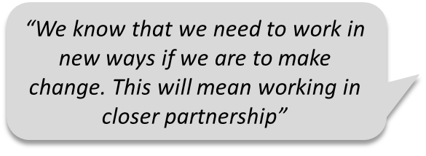
Aligning our strategic priorities

Slide 5
Commissioning vision for Greenwich | What are the challenges?
WORKFORCE CHALLENGES
Colleagues recognise they will need to learn and develop new ways of working, many with limited experience of:
outcomes based specification development and contract monitoring,
developing hybrid approaches to service delivery and reporting with providers – not exclusively inputs/activities or outcomes,
incentivising outcomes and impact, not just activity/tasks,
co-developing solutions with potential/actual providers,
consumer input and co-creation – not just consultation,
migrating from universal services to tailored/multi-faceted interventions around the person,
market engagement and facilitation, and
alignment and consolidation.
DEMOGRAPHIC CHALLENGES
Healthy life expectancy in Greenwich notably worse than regional and national averages; inequalities in health & wellbeing across neighbourhoods.
Continuing growth in demand for NHS and social care services, persisting health problems and backlogs.
Growing number of people with complex long-term conditions.
Financial challenges caused by increasing demand and ongoing pressures
COMMISSIONING CHALLENGES
Diverse stakeholder priorities.
Lack of shared understanding of ‘what matters’ to communities; limited influence over services.
Fragmented services often difficult to navigate.
Siloed working with one-way relationships.
Limited opportunity for innovation.
Services and targets based on activities and inputs.

Slide 6
OUR vision for commissioning in Greenwich
We want to ensure that in Greenwich, people’s health, care, learning, wellbeing and relationships support them in living their best lives.
To do this we need to be commissioning for transformational change in the way we deliver our services for people, neighbourhoods and place.
Our ambition is to enable our residents, providers and other stakeholders to co-design the development of our services, based on what matters most to Greenwich people.
This will mean a far greater focus on local services, join-up, outcomes, collaboration and impact.
Preventing avoidable poor outcomes, promoting and protecting good health, learning, safety and wellbeing and tackling health and care inequalities will remain key priorities.
This executive summary set out the findings from this work, which is intended to inform further conversations within the Council and across the ICB about what a new commissioning structure could look like, as well as recommendations for how this work should be taken forward in conjunction with the remainder of the Horizon 3 Action Plan.

Slide 7
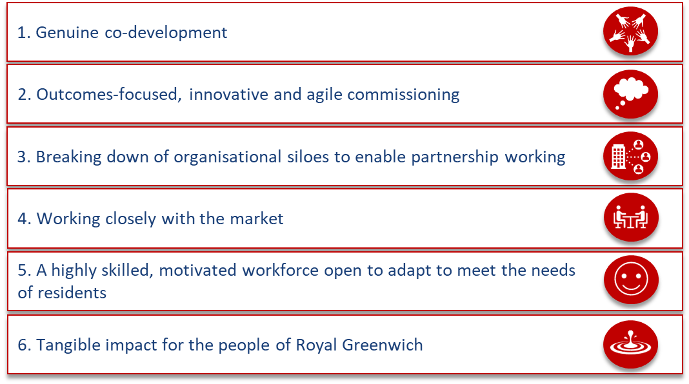
Shift in commissioning practice
Our 6 commissioning ambitions
Shift to Horizon 3 commissioning

Slide 8
A COMMISSIONING APPROACH FOR GREENWICH
Framed by our operating model
System working
Workforce
Value for money
Outcomes-focus
Benefits
OUR GREENWICH PLAN
Co-
production
Innovation
Leadership
Based on the Task and Finish Group sessions with commissioners, this proposed summary of Greenwich’s commissioning approach, is aligned to best practice commissioning approaches and tailor-made to capture the borough’s ambitions for the impact that we want commissioning to achieve in the coming years.
People, carers and families
Relationships
Delivering quality
Tailor-made for Greenwich
People, families and carers at the heart of everything we do
Shared ambition
Decision-making
Guided by the Our Greenwich Plan, setting the strategic direction
Our 'enablers'
Outcome-based services
Our 'core principles'
Our underpinning operating model
Insight

