Slide 1

Adult Social Care In Cheshire West & Chester

Slide 2

Our Borough
Our Borough
357,147
Population
42 General Practices
2 Hospitals
2 Community Health Providers
75,750
Residents 65+
Cheshire & Merseyside ICS
2nd largest in England (pop.2,714,167)
University City
Industrial Towns
Rural Villages
Market Towns

Slide 3
Adult Social Care
1,780
Number of carers supported
9,400
Current number of people we are supporting
5,215
Current number of people in receipt of long term support
18,604
Number of contacts with our Community Access Team in 21/22
7,030
Number of referrals for assessment in 21/22
1,355
Number of people in Care Home Placements
33,900
Current hours of care at home commissioned per week
2022/23 Finance (£m)
Service | Budget | Forecast | Underlying Position | Mitigating Actions | Variance
Council | 352.2 | 369.2 | 17.0 | (16.4) | 0.6
Commissioning, Contracts and Quality Assurance | 5.7 | 5.6 | (0.1) | - | (0.1)
Adult Social Care | 107.1 | 116.1 | 9.0 | (2.5) | 6.3

Slide 4
Our Structure
Delyth Curtis
Deputy Chief Executive (Health and Wellbeing) DASS and NHS Cheshire & Merseyside Place Director
Charlotte Walton
Director Adult Social Care & Health
VACANCY
Head of Adult Social Care
Matthew Emerson
Head of Commissioning, Contracts & Quality Assurance
Roger Fenton
Senior Manager, Learning Disabilities, Complex Review and Continuing Health Care
Nadia Van Der Wath
Principal Occupational Therapist
Senior Manager Hospital and Reablement
Gavin Butler
Principal Social Worker
Senior Manager Mental Health Services and Home Assessment Team
Kate Phillips
Senior Manager, Contracts & Quality Assurance
Michelle Taylor
Senior Manager, Adult Social Care Commissioning
Phil Green
Senior Manager, Community Social Work, Occupational Therapy and Visual Impairment Teams
Karen Owen
Senior Manager, Adult Safeguarding, MCA & DoLs, Review & Community Access
Emma Cleminson
Portfolio Manager, Adult Social Care Transformation

Slide 5

OUR VISION: “One team, putting what matters to people first”
Mission
Supporting people to live a great life by providing the care and support they need, in the place they call home by a skilled and compassionate workforce
Objectives
Collaboration
Fostering connected and resilient communities
Focussing on strengths
Moving towards prevention
Meaningful and inclusive engagement
Confident and committed workforce
Quality and safety in practice

Slide 6
Our Strengths
Attitude to risk management & audit
Strong & visible leadership
Collaboration & partnership working
Political Engagement & Governance
Approach to transformation & innovation
Complex care and review team

Slide 7
Our Challenges
Demand management
Consistency
Co-production
Workforce
Budget

Slide 8
Finance
Total of £24.3m growth in 23-24
Council supports a longer term view on savings setting out 2-4 year savings plan to achieve targets
Policy Options Delivery Board established to monitor delivery of financial proposals
Policy Options Savings (£000)
23-24 | 24-25 | 25-26 | 26-27
6,567 | 9,797 | 6,867 | 1,222

Slide 9
Community Led
Support
Cross cutting transformation programme
“The way we do things here”

Slide 10
Community Led
Support
Innovation Board
Let’s Talk | Default Digital | Direct Payments | Training & Development | Community Led Care & Carers
Public facing, multi agency hubs in the heart of communities | Improving our customer digital journey and enhancing our self assessment offer | Improving our offer around Direct Payments and what they can be used for (e.g., micro enterprises) | Programme of training to develop and embed ways of working | Recommissioning our community sector services in a more flexible and agile way to support prevention
Outcomes
Reduction in call volumes Reduction in assessments Reduction in long term care requirements Improved support offer £1m savings

Slide 11
Demand
Management
Strategic Change |  |  | Tactical Change
Reablement Workstream | ICT/Rostering | OT Workstream | Operational Change
Improving peoples access to reablement in order to achieve better outcomes and prevent the need for long term support | Procurement of replacement rostering and mobile app systems | Developing an OT First offer across our services | Implementing agile changes to deliver maximum benefits
Outcomes
Improved access Community facing reablement offer Reduction in demand on long term care £9.5m savings

Slide 12
Learning Disabilities
Night time support | Complex Care & Review | Day Opportunities Transformation | Vivo
Delivering a new model of overnight support to maximise use of technology and independence. | Continue programme of reviews and planning to support people back into and to remain in borough and to plan effectively for young people coming through transitions. | Transforming our day opportunities provision through co-production to modernise our offer, improve choice, outcomes and use of resources. | Provider of learning disability services transferred back into the Council.
Outcomes
Improved choice, control and independence Wider choice of support available Increase use of technology based care solutions £4m savings

Slide 13
Commissioning Transformation
Market Shaping
Experience and Outcomes | Whole-life focus | Forward thinking & outward looking | Strengths & Assets | Co-production | Outstanding Quality
Developing successful services that will provide good experiences and support people to live great lives (e.g., an outcome-based commissioning model for Care at Home). | Joining up our thinking and planning to seek opportunities which support people across their whole life (e.g., day services, respite, specialist housing) | Creating new partnerships, finding new ways and planning further ahead to shape the care and support models and markets of the future (e.g., strategies, market shaping collaborations) | Designing services which enable people to live their lives in the place they call home and to utilise the things in their community (e.g., day service review, direct payment review) | Involving people who use services and their families and carers in the design and production of new services (e.g., Community Grants, care at home) | Collaborating with providers to improve people’s lives by driving up standards and improving quality (e.g., QA and Improvement Framework, Registered Manager development (care homes))
Outcomes
Better experiences, outcomes and quality of life for people Reduction in demand for long term care Reduced cost Higher quality care £2.3m savings

Slide 14







Transitions Programme
Doing things
differently
Complex Care and Review
Mental Health Re-design
Care at Home Re-commission

Slide 15
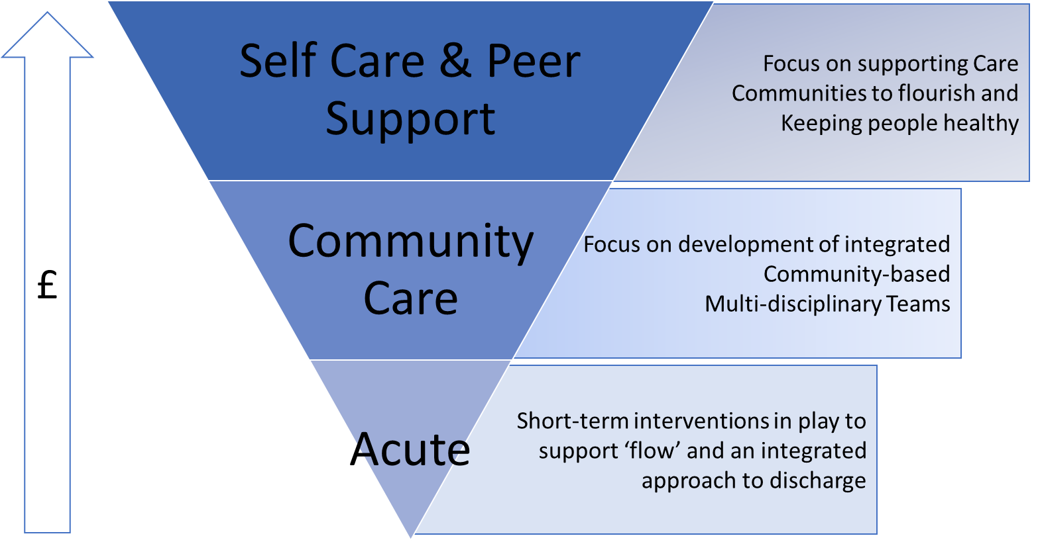
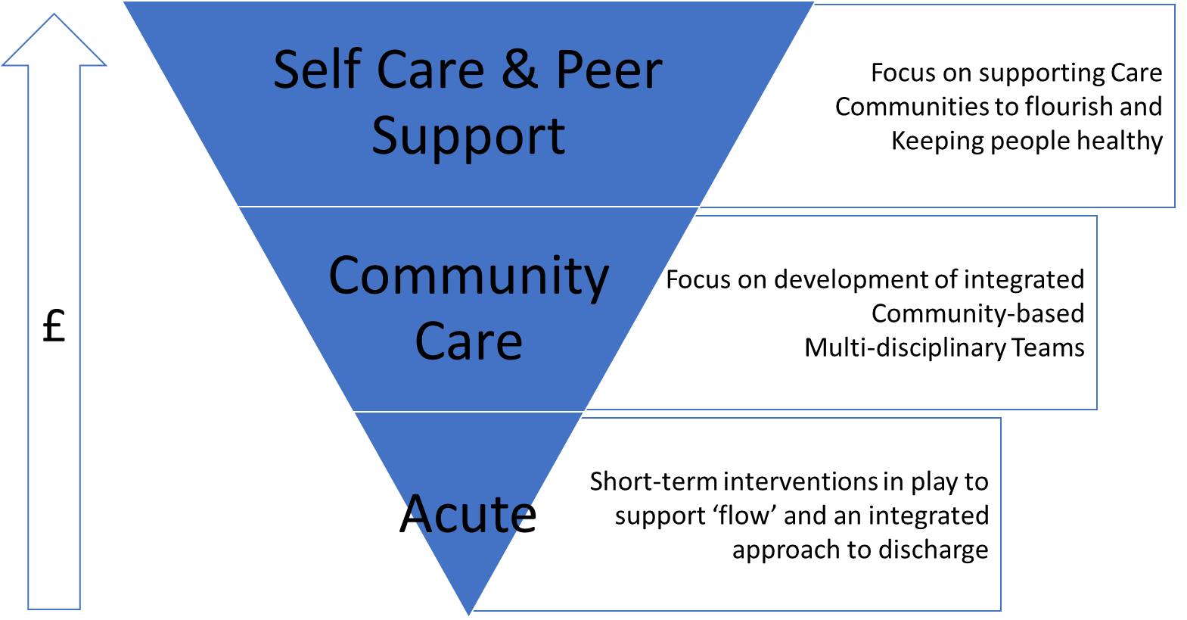
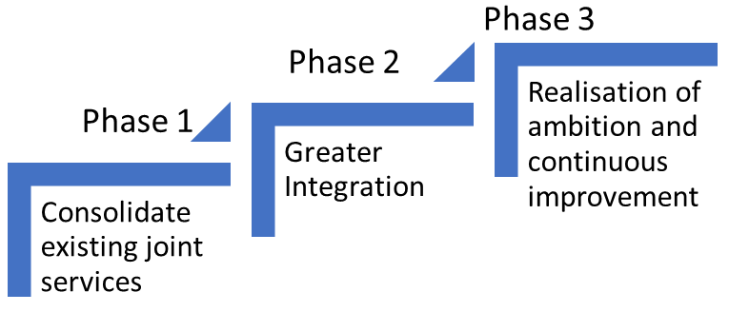

Place Ambition
Our governance will be impactful
We will invest in Place Leadership and advocacy of primacy of Place
We will thrive in the delivery of our Place Plan Pledges
We will optimise integration of our services to improve outcomes
We will support our communities to flourish

Slide 16
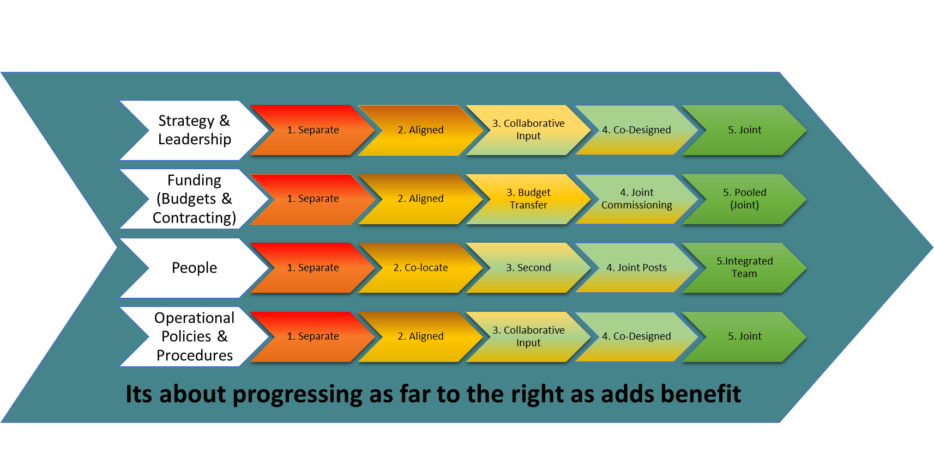
Place Objective

Slide 17
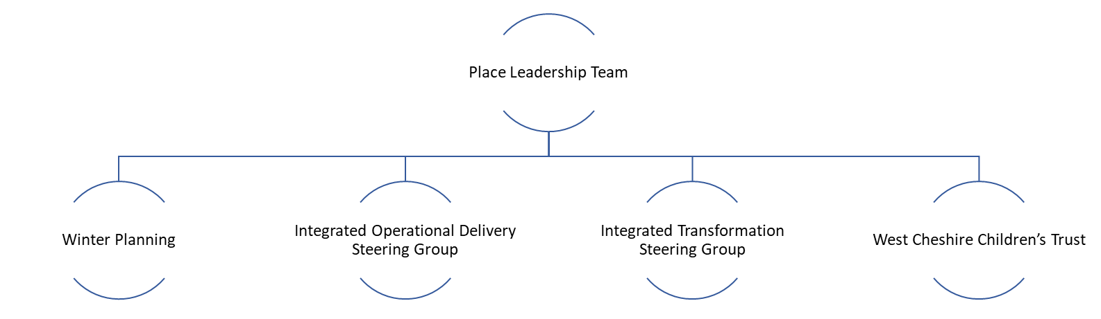
Place Transformation Plan 23/24
Governance
1
2
3
4
Strategic Intent: Demand management, Home First, Investment in communities
Transformation Programme
Demand
£
Home
First
Self Care and Peer Support – Supporting Communities to Flourish
Community Care – Development of Integrated multi-disciplinary teams
Acute – Improving flow
Managing people in their homes and communities
Community
Care (Incl
Admission
Avoidance)
(2&3)
Community Partnership Strategic Programme
(3)
All age Mental Health
(2&3&4)
All age LD &Autism
(2&3&4)
Supporting people in crisis to remain at home and enabling safe discharges to home
Intermediate Care/ Integrated Discharge
(1&2&3)
Health-led interventions to reduce admissions

